Slide 1
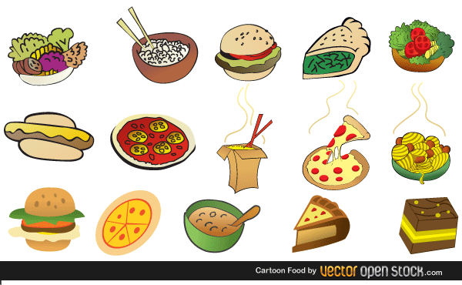
Food founder(demo)
By: Linan He
Class project : Mac125
Mobile App

Slide 2
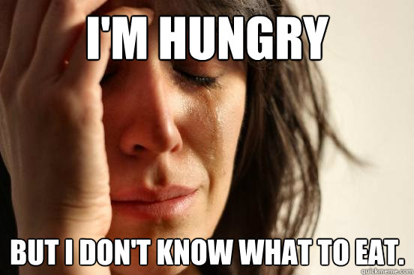
How you ever just don’t know what to eat?

Slide 3
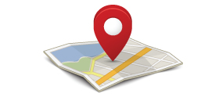
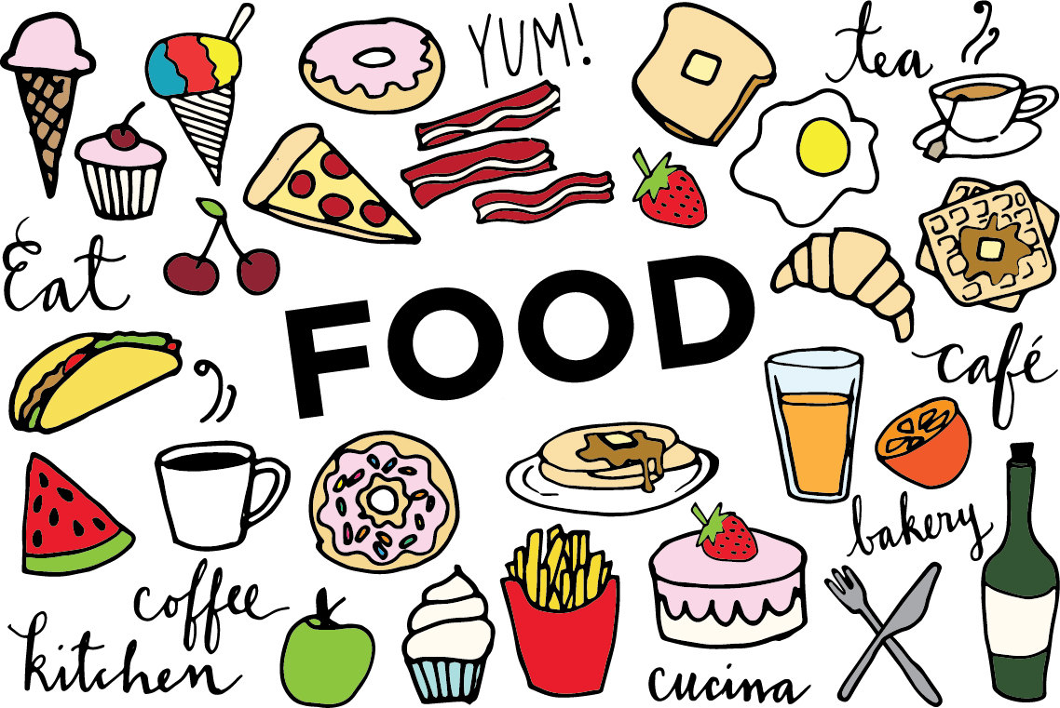
With Food Founder, we can help you with just that.
All we need to know from you is your current location or
The general location you going to be.
and we will solve the rest of it for you.

Slide 4
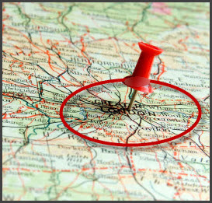
The program will automatically help you find the nearest restaurants of food you like in current radius.

Slide 5
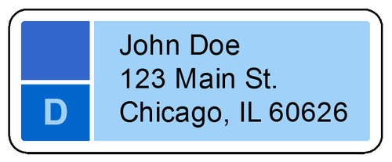
For example:
I’m right now at home
And my address is 132-65 54th ave ,
queens, NY ,11542
By knowing your address or current location.
you can use that information to find restaurants near that area.

Slide 6

In the app. It will only ask you for the address.
So in my case the app will tell me to enter my door number and street together
Enter: 132-65 54th ave
Second it will ask for the borough
Enter: queens
Third it will ask for the state
Enter: NY
Lastly it will ask for the zip code
Enter: 11542

Slide 7
After the app receive your information
It will look into all the data of restaurant near that area.
The result of my information that app take in
It will shows me:
Place name, price range, customer review , address, and also will shows two dish they have in there.

Slide 8
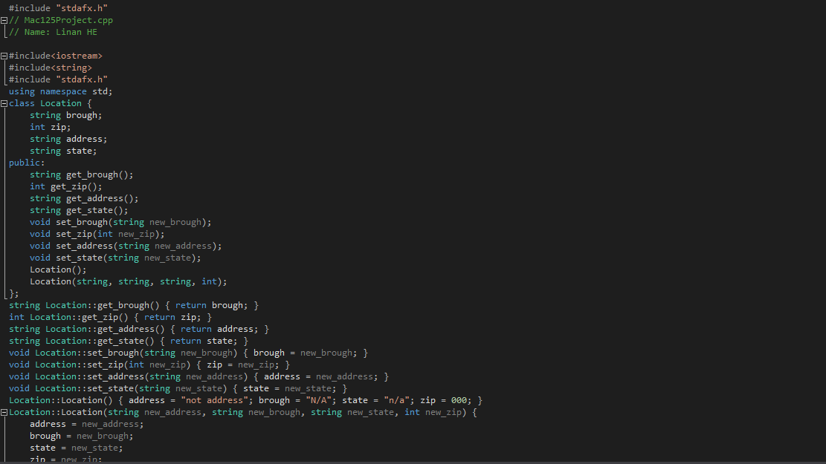
Screen shot of part of the code

Slide 9
Now with this app you don’t ever have to wonder where to eat anymore, not only will it help you to try new food in the area but also help you getting to know the area better.

